Slide 1
INTRODUCTION TO MICROSOFT OFFICE (PART 1 MICROSOFT POWERPOINT) LAB # 04
Fall 2021
CSE102L Computer Programming Lab
Submitted by: Ali Asghar
Registration No. : 21PWCSE2059
Class Section: C
Submitted to:
Engr. Abdullah Hamid
December 13, 2021
Department of Computer Systems Engineering
University of Engineering and Technology, Peshawar

Slide 2
ATOMIC PHYSICS
Atomic physics is the field of physics that studies atoms as an isolated system of electrons and an atomic nucleus
It is primarily concerned with the arrangement of electrons around the nucleus and the processes by which these arrangements change
This comprises ions, neutral atoms and, unless otherwise stated, it can be assumed that the term atom includes ions.
The term atomic physics can be associated with nuclear power and nuclear weapons, due to the synonymous use of atomic and nuclear in standard English.

Slide 3
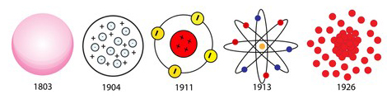
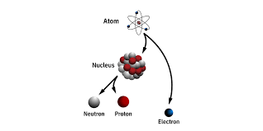
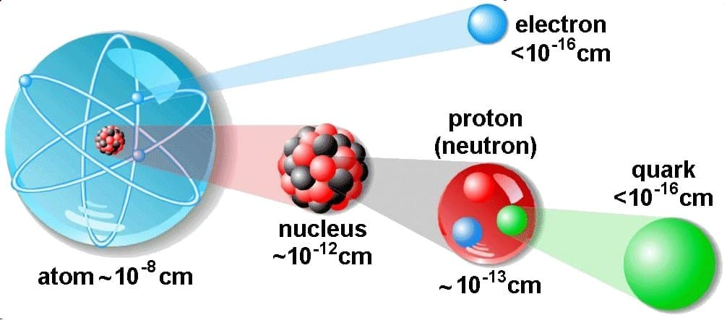
Structure Of Atom
History Of Atomic Model
Basic Atom Structure
Sizes of atomic components

Slide 4
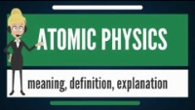
Atomic Physics Basic Intro

